Slide 1
Status Report 5/10/2022
Project Name: Skin Job
Class: DSE-I2100
Instructor: Michael Grossberg
Group Member: Gong Qi Chen, HuiHuang Liu

Slide 2
Agenda
Report
Data Preprocessing
Image Resolution
Dealing with imbalance data set
Oversample
Undersample
Weight
EfficientNetB1 Model Evaluation
Future Work

Slide 3
Report
https://github.com/HuihuangLiu001/DSEI210-Final-Project--Skinjob/blob/main/reports/Final_Report.ipynb

Slide 4
Data Preprocessing - Image Resolution
48x48 for Sklearn Models (Linear, Logistic and SVM)
Due to lack of resource
240x240 for Keras Models (DNN, CNN)
Keras provide function to create data generator

Slide 5
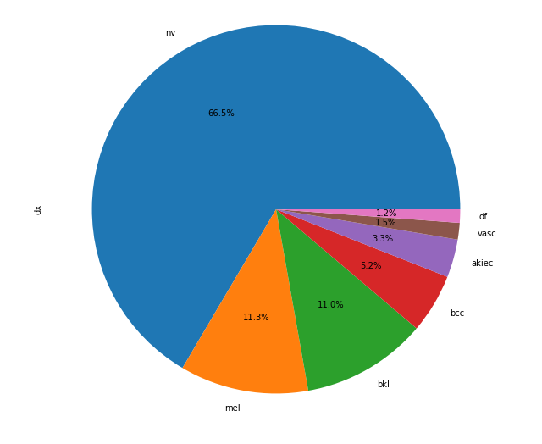
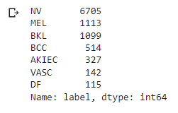
Imbalance Dataset

Slide 6
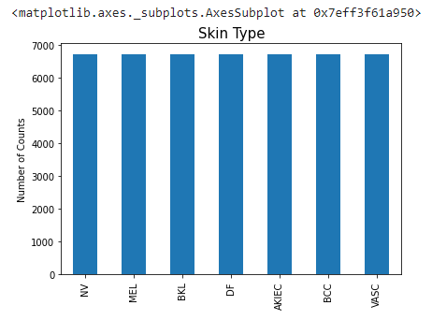
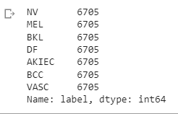
Oversample
Too many data with limited resource

Slide 7
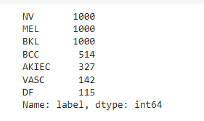
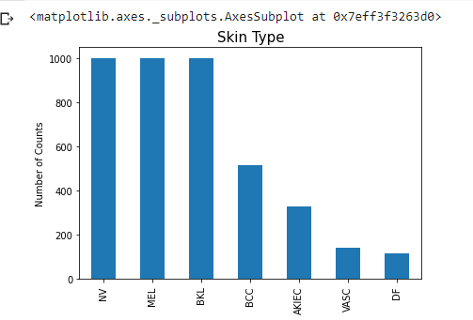
Undersample
Only partial data cause overfitting

Slide 8
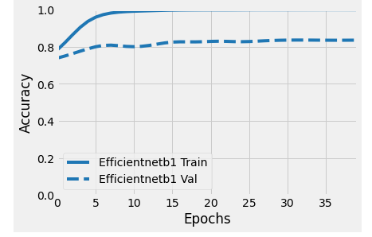
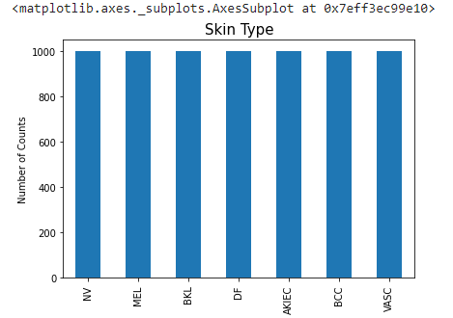
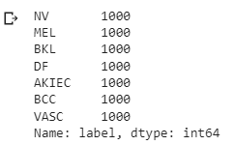
Balance Sample
Oversample after downsample

Slide 9
Weight
Slower than downsample but less overfitting
Highest label count / target label count

Slide 10
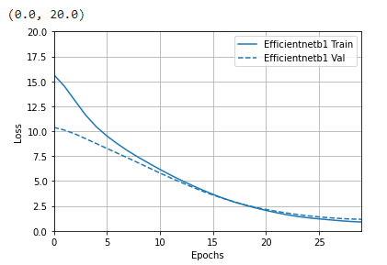
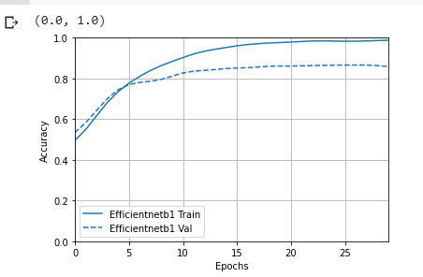
EfficientNetB1 Model Evaluation

Slide 11
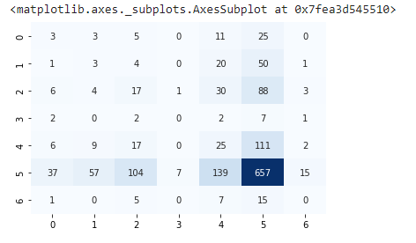
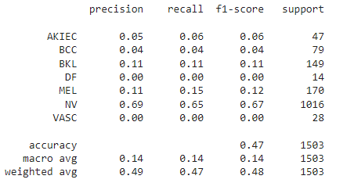
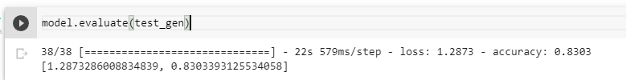
EfficientNetB1 Model Evaluation

Slide 12
Future Work
Hyper-Tuning the models
Complete the Final Report
Packaging the code
Documentation

Slide 13
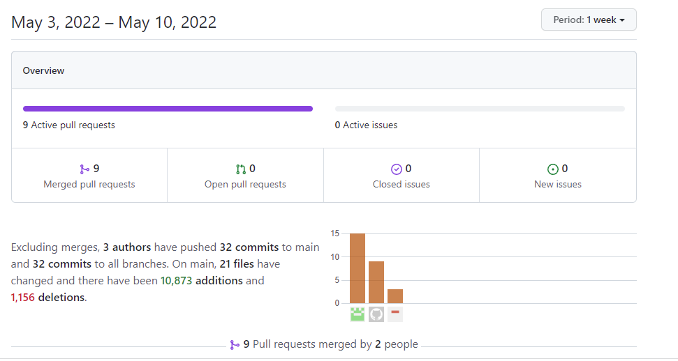
Github Commit Summary

